Slide 1

Variational Mixture of HyperGenerators for Learning Distributions over Functions
Ignacio Peis
ipeaz@dtu.dk
Technical University of Denmark
Honolulu, Hawaii
July 2023

Slide 2

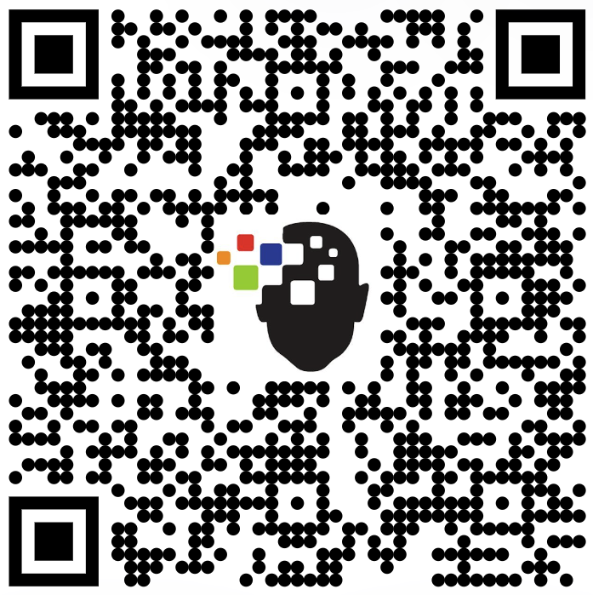

Collaborators
Batuhan Koyuncu¹ Pablo Sánchez^{1,2} Ignacio Peis³ Pablo M. Olmos⁴ Isabel Valera^{1,5}
[Paper]
[Code]
¹ University of Saarland
² Max Planck Institute for Intelligent Systems
³ Technical University of Denmark (DTU)
⁴ Universidad Carlos III de Madrid
⁵ Max Planck Institute for Software Systems

Slide 3
Deep Generative Models
Learning probability distributions on data using Deep Neural Networks.
Implicitly
Explicitly
Generative Adversarial Networks (GANs [1])
Variational Autoencoders (VAEs [2])
Denoising Diffusion Probabilistic Models (DDPMs [3])
Score-based models [4]
Energy-based models [5]
[1] (Goodfellow et al., 2014)
[2] (Kingma et al., 2014)
[3] (Ho et al., 2020)
[4] (Song et al., 2019)
[5] (Lecun et al., 2006)

Slide 4
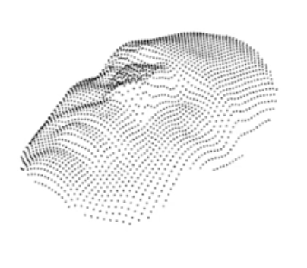
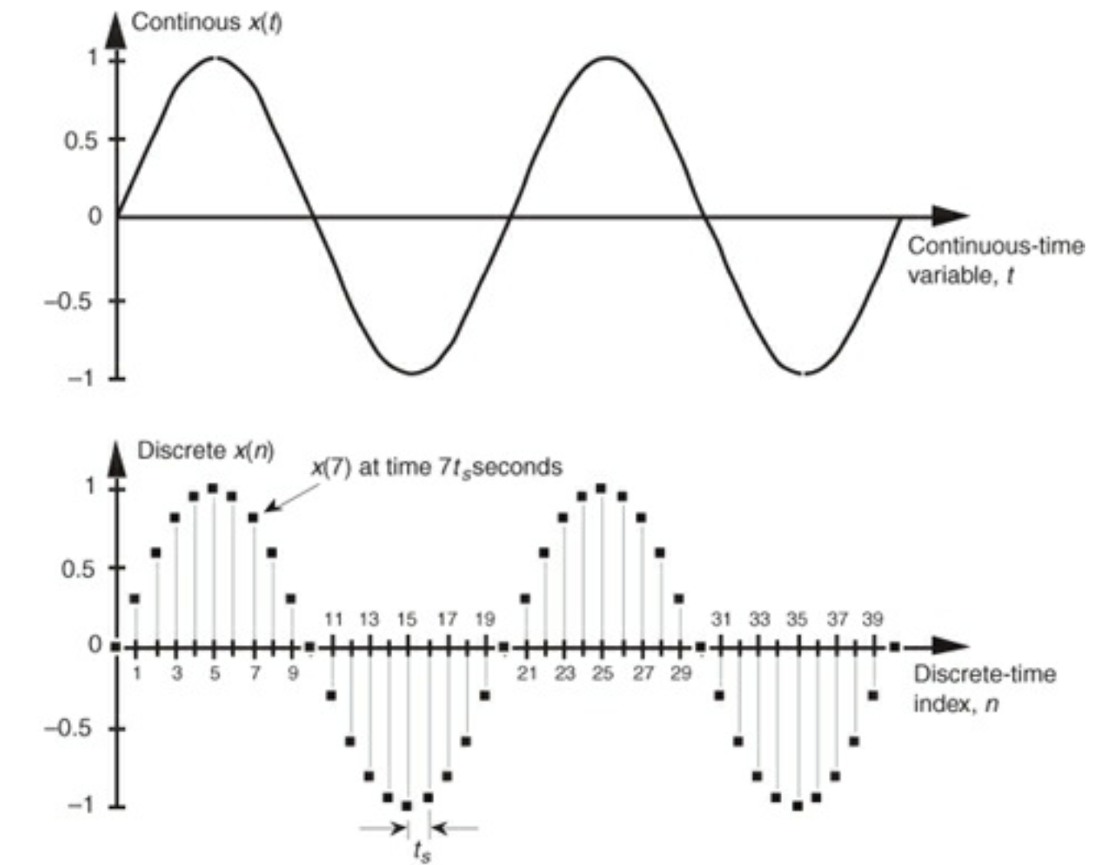
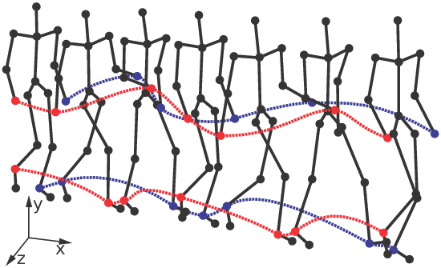
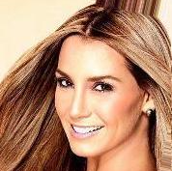
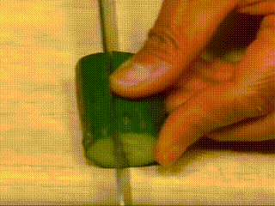
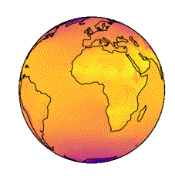

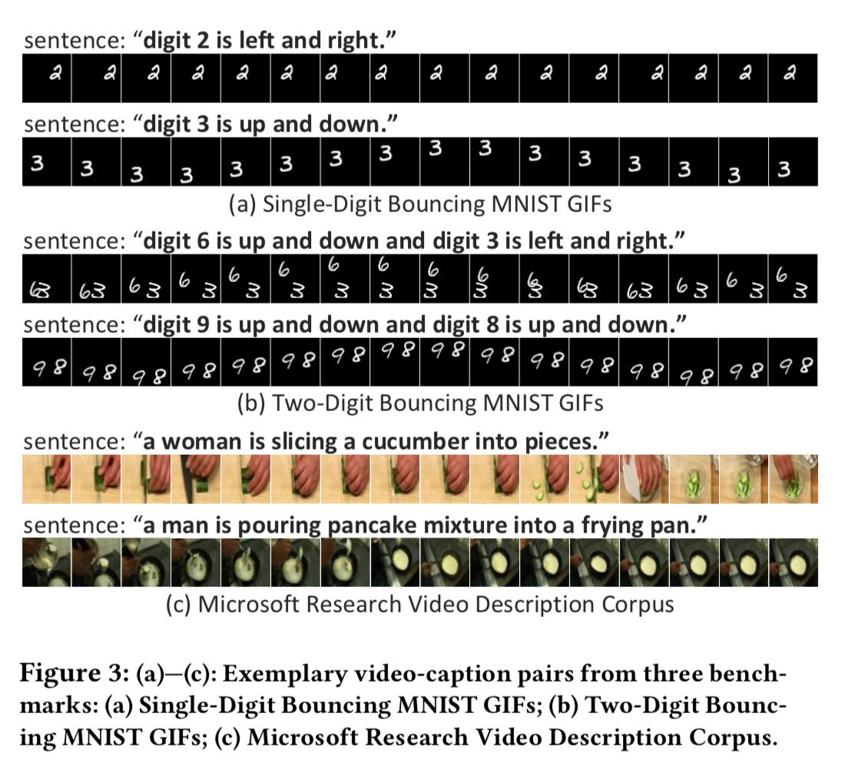
Discretization of data
We typically deal with discretized versions of data that are continuous in nature.
3D shapes
Signals
Motion sequences
2D Images
Videos
Polar data
Audios
Spatial
Temporal
Spatio-temporal

Slide 5


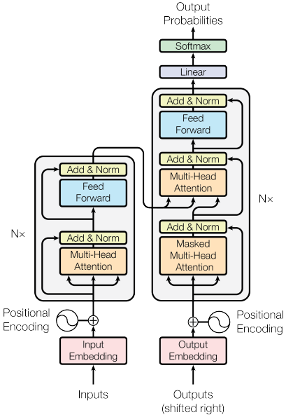
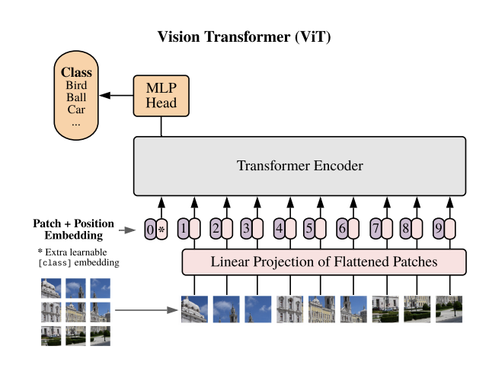
NNs to exploit discretized data
DNNs are tailored to the data nature.
CNNs, Vision Transformers
RNNs, Transformers
CNNs, RNNs, Transformers
[8]
[6]
[7]
[9]
Spatial
Temporal
Spatio-temporal
[6] (Simonyan et al., 2014)
[7] (Dosovitskiy et al., 2020)
[8] (Hochreiter et al., 1997)
[9] (Vaswani et al., 2017)

Slide 6
Real data is continuous in nature
What if we approximate the underlying continuous functions?

Slide 7
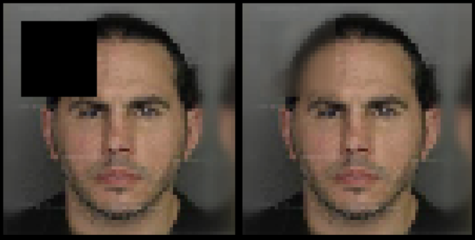
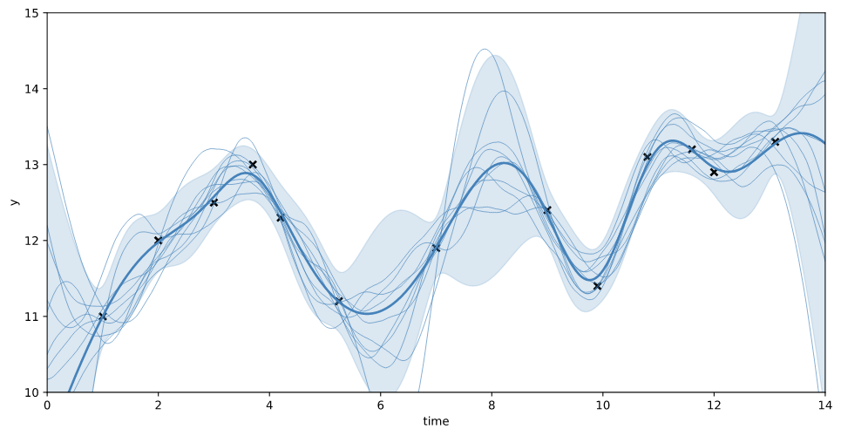
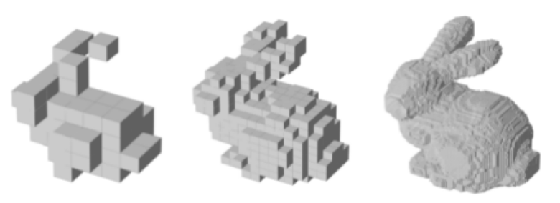
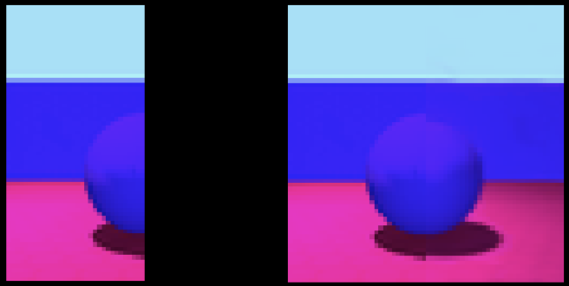
Real data is continuous in nature
Learning the distribution of a function allows for naturally handling:
We can use the same neural architecture independently of the data nature.
Information to store will be independent of the data size.
Inpainting
Super-resolution
Conditional generation
Outpainting

Slide 8
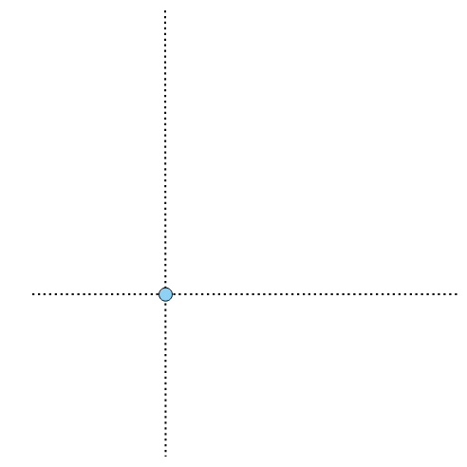

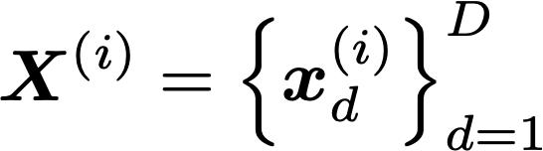
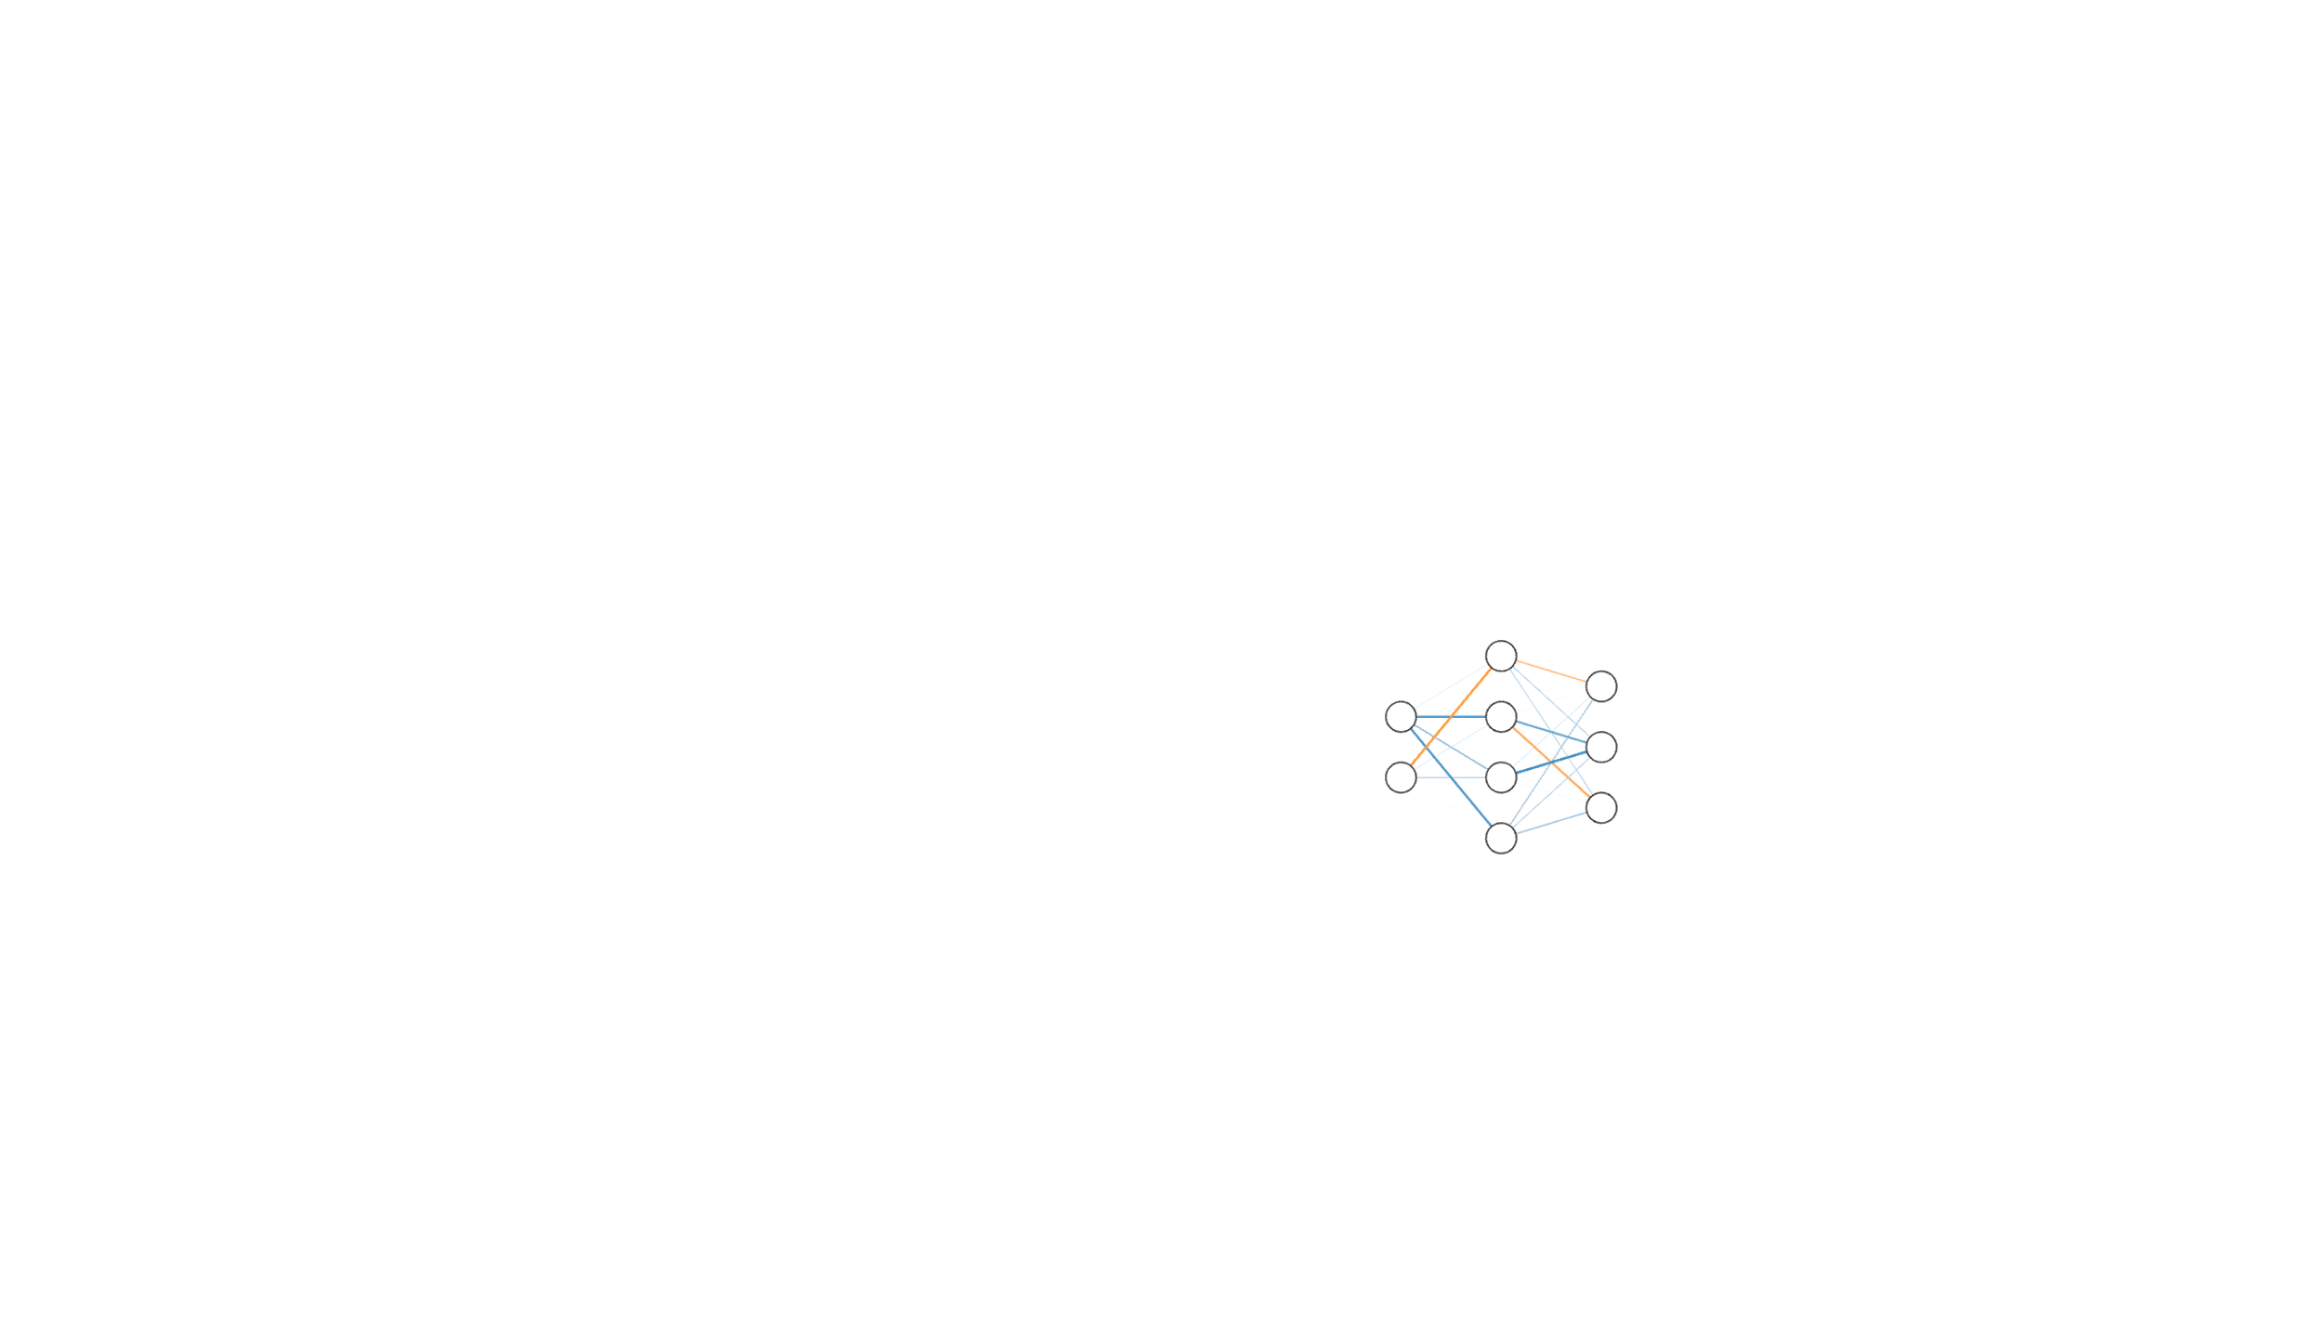
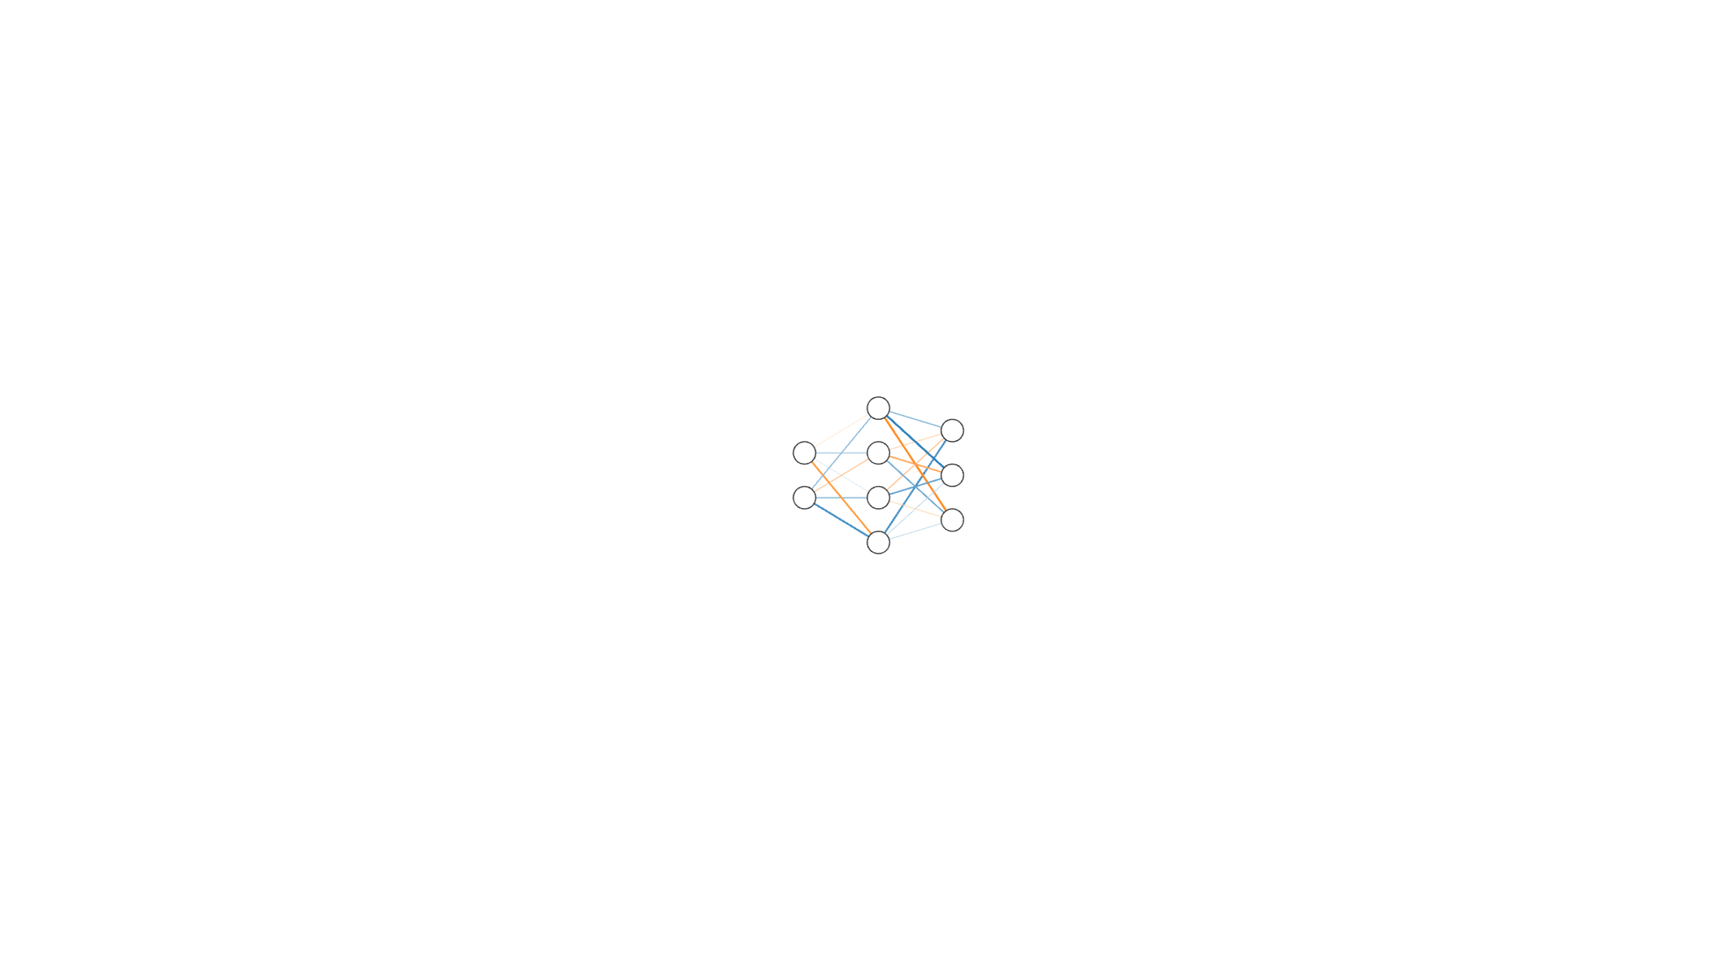
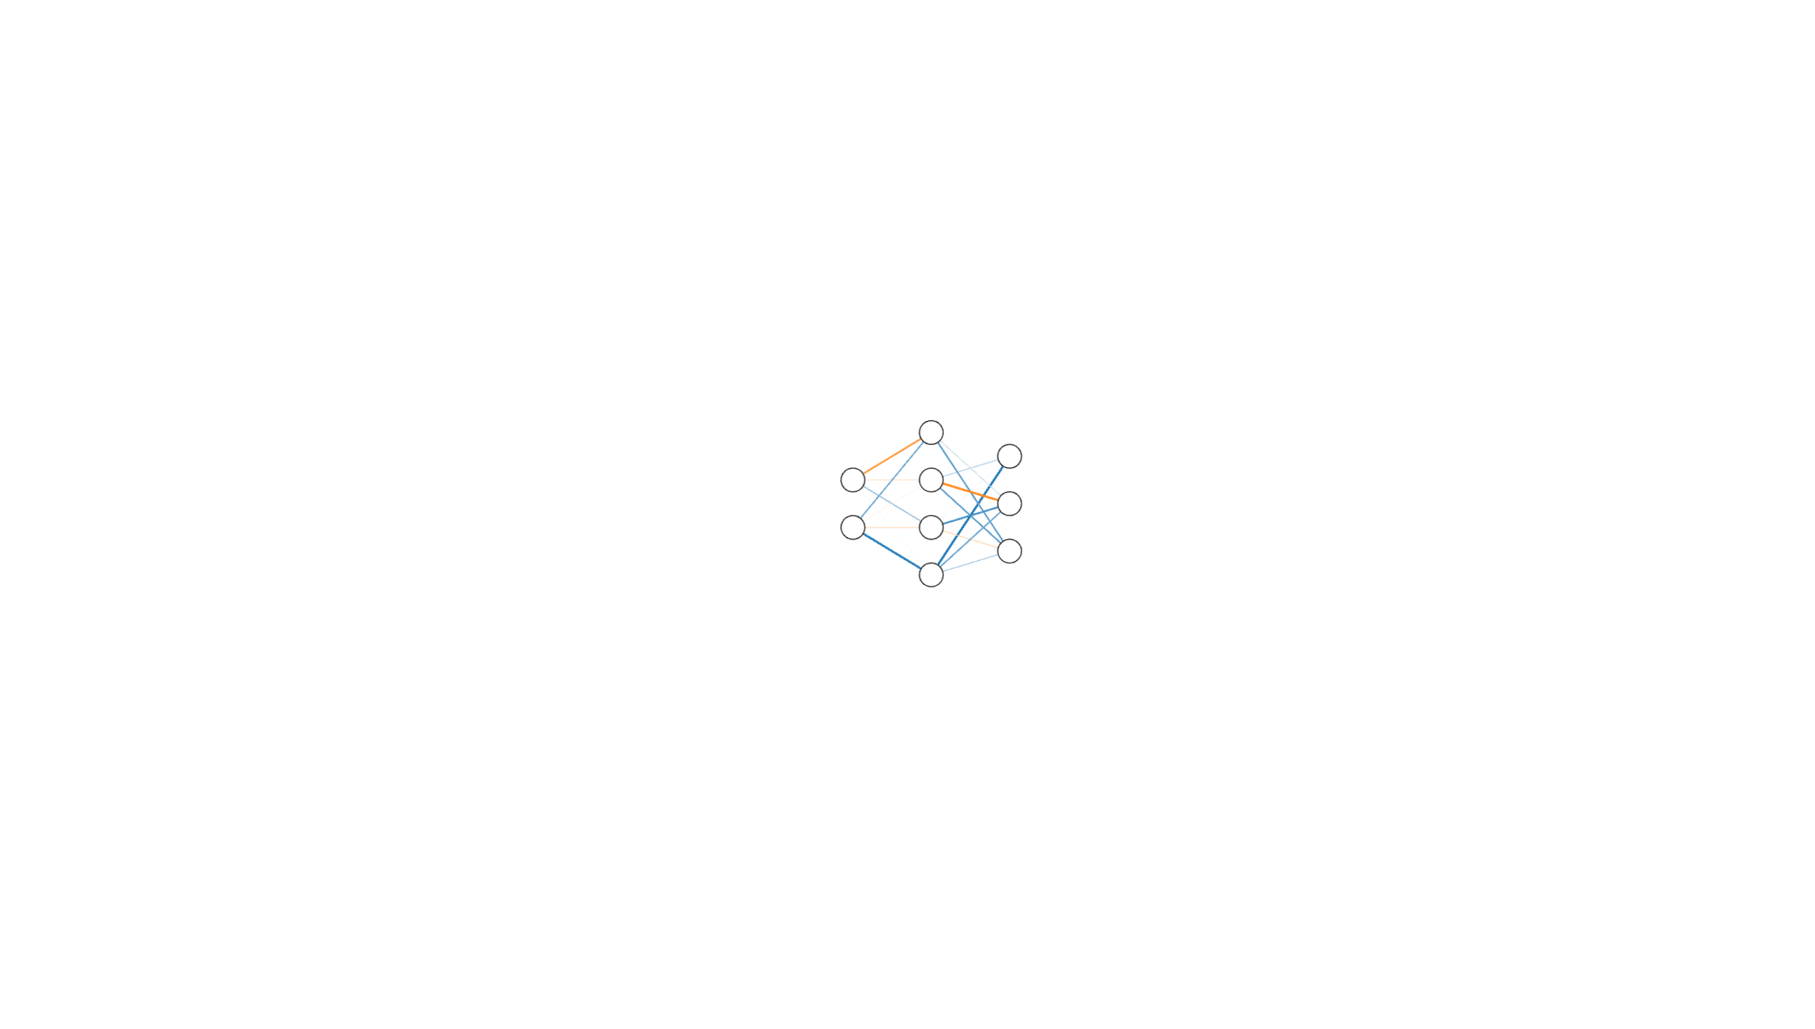
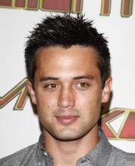
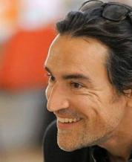
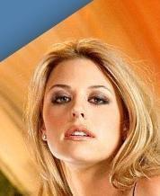
Implicit Neural Representations
INRs [10-12] can approximate these functions.
How to efficiently learn unique INRs per datapoint?
DGM that generate weights!
[10] (Sitzmann et al., 2020)
[11] (Mescheder et al., 2019)
[12] (Stanley et al., 2007)

Slide 9
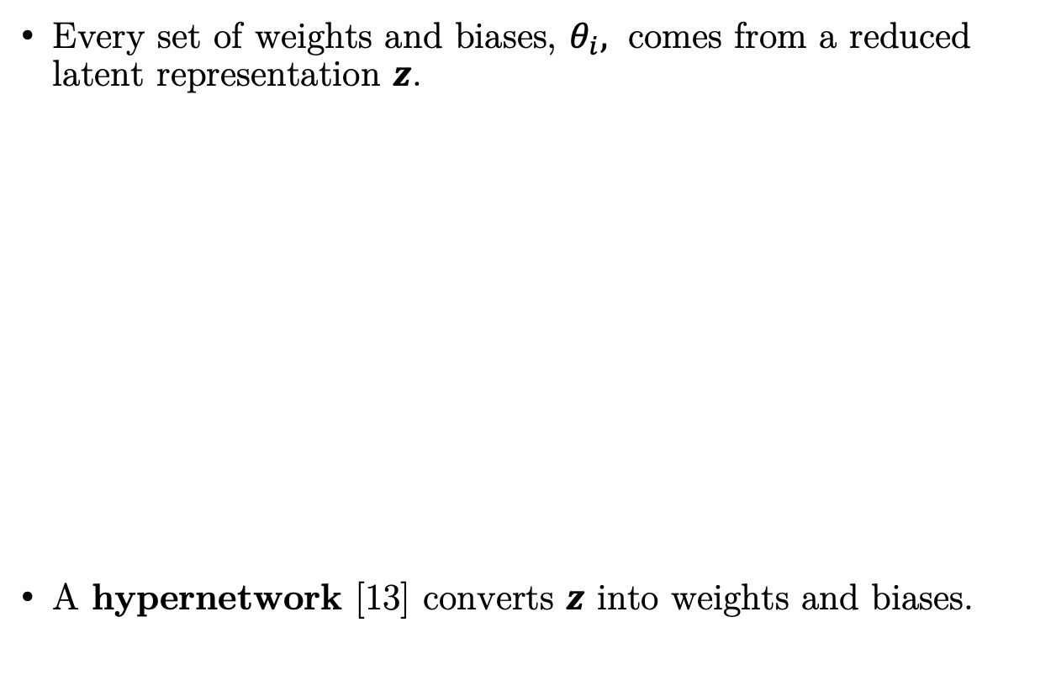
Our proposed method
Every set of weights and biases, $θ_{i},$ comes from a reduced latent representation $z$.
A hypernetwork [13] converts $z$ into weights and biases.
[13] (Ha et al., 2017)

Slide 10
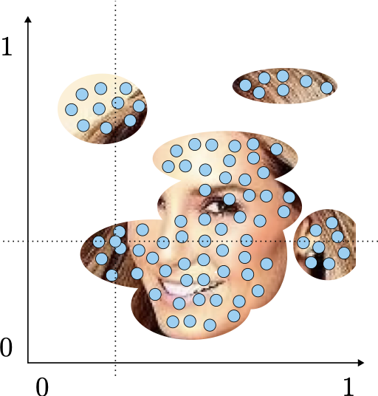
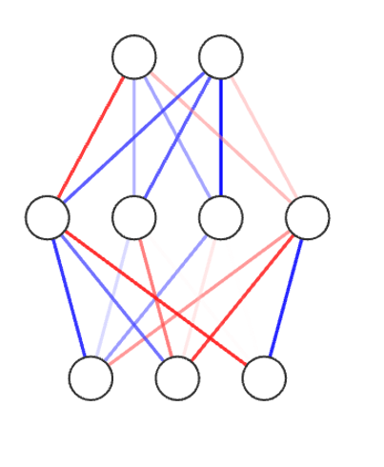
Our proposed method
To learn the parameters of our model, we opt by using Amortized Variational Inference, and optimize the following ELBO.
Point Convolutional encoder [14]
[14] (Wu et al., 2019)

Slide 11
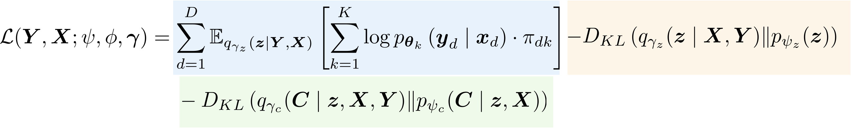
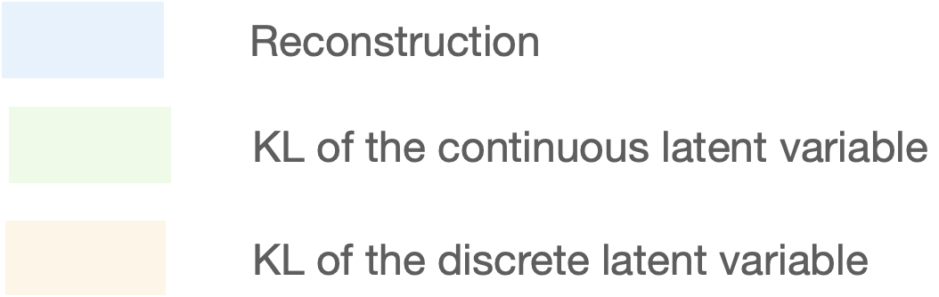
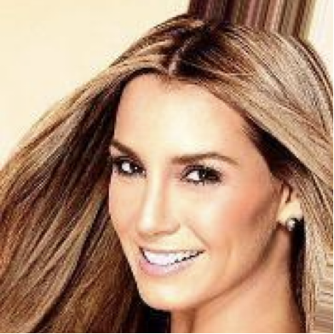
Our proposed method
We incorporate a Mixture of HyperGenerators for increased flexibility.
component

Slide 12
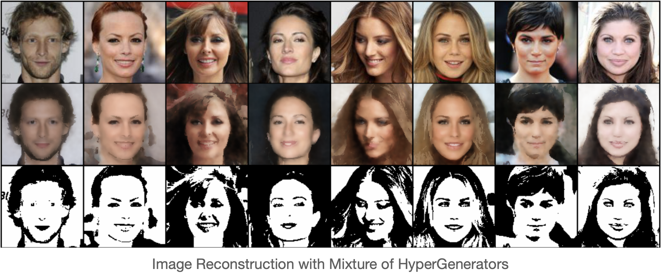
Our proposed method
We incorporate a Mixture of HyperGenerators for increased flexibility.

Slide 13
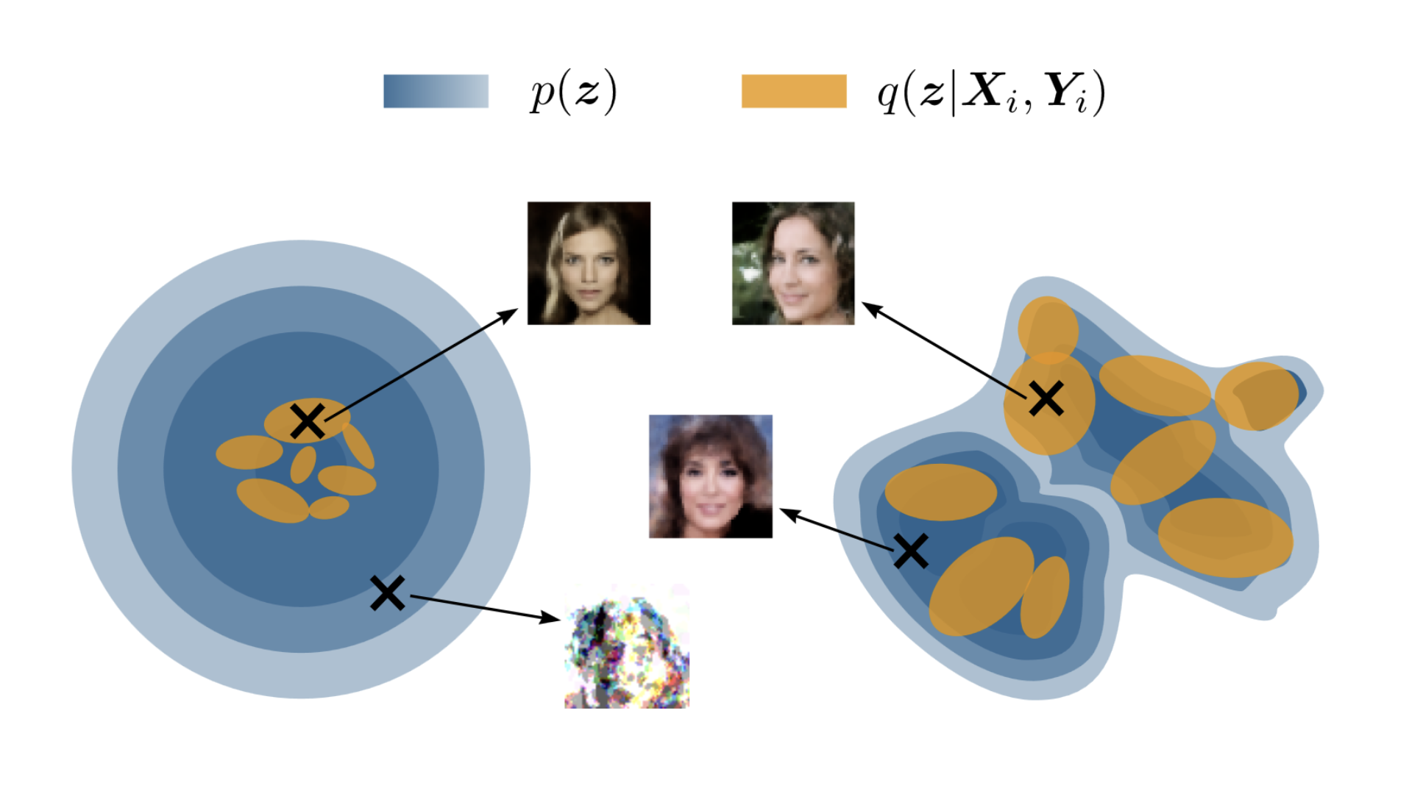
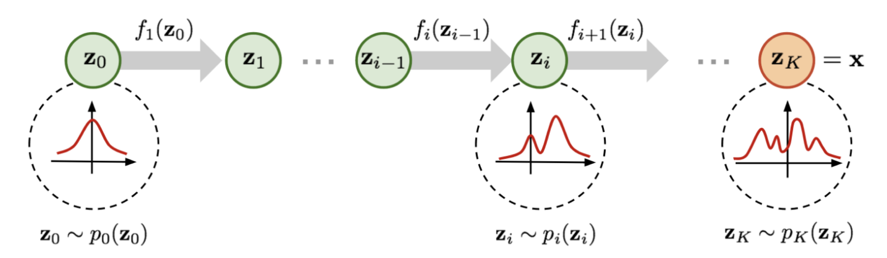
Our proposed method
To alleviate the holes problem, similarly like Latent Diffusion models [15], we learn the prior as a planar Flow [16].
[15] (Rombach et al., 2022)
[16] (Rezende et al., 2015)

Slide 14
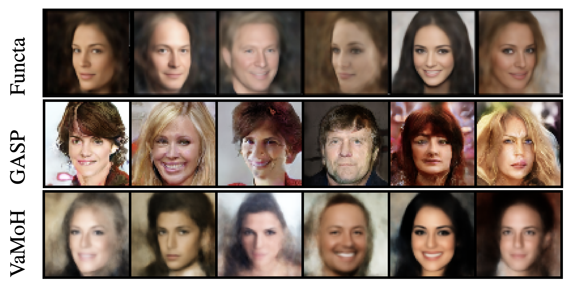
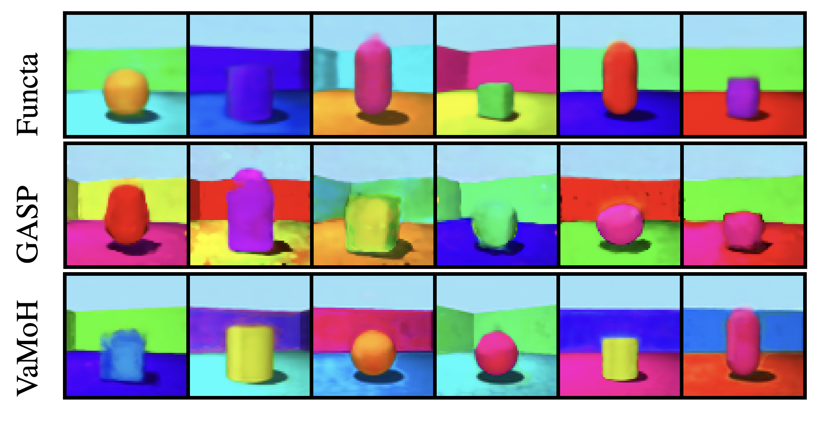
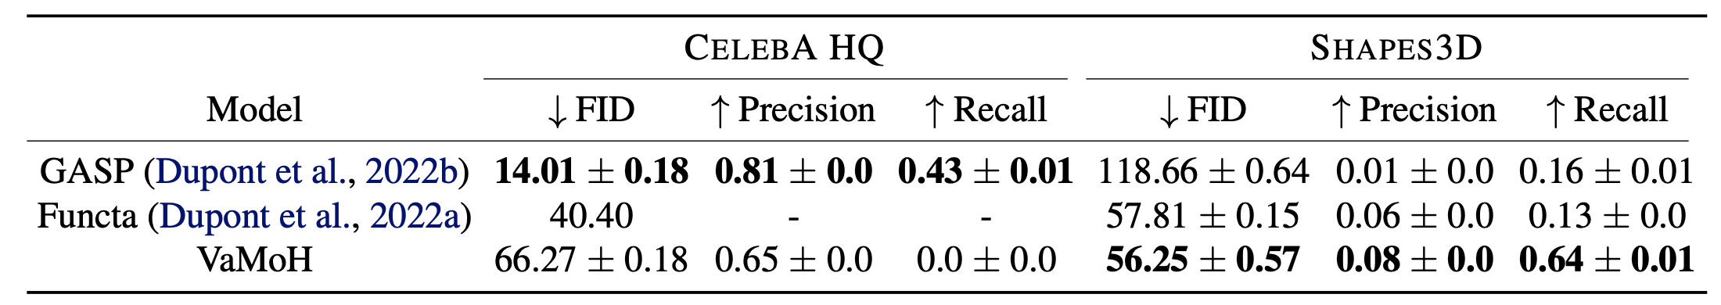
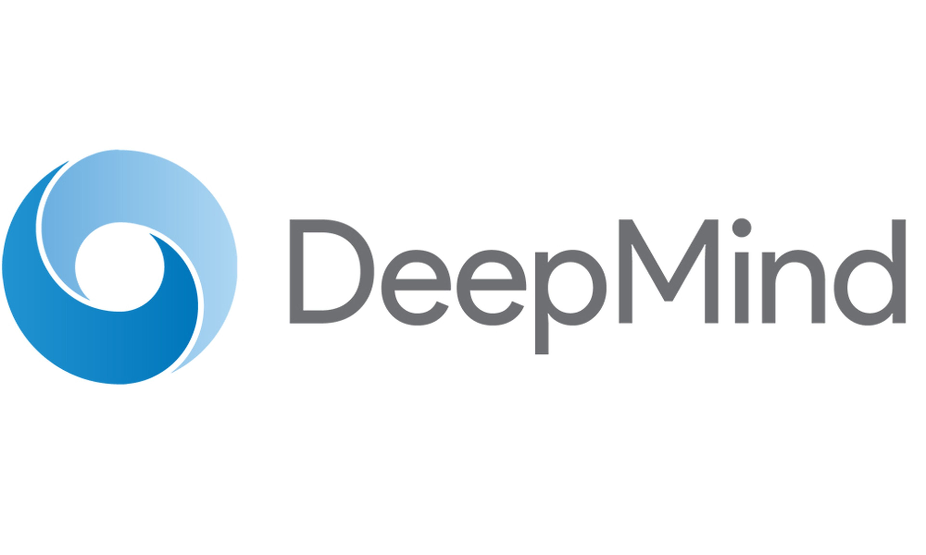
Results
We achieve comparable sampling quality and diversity wrt baselines.
[17]
[18]
[17] (Dupont et al., 2022a)
[18] (Dupont et al., 2022b)

Slide 15
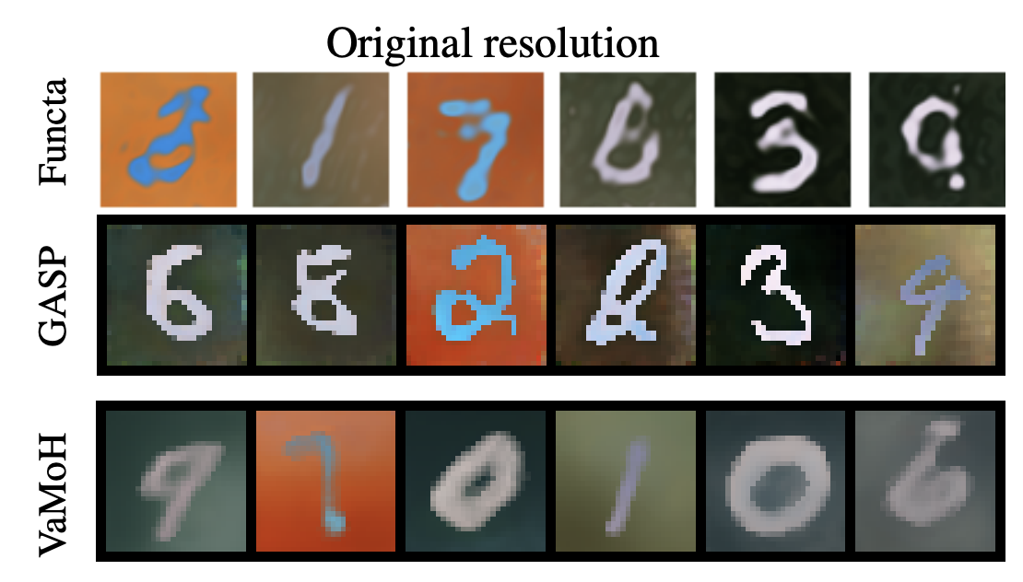
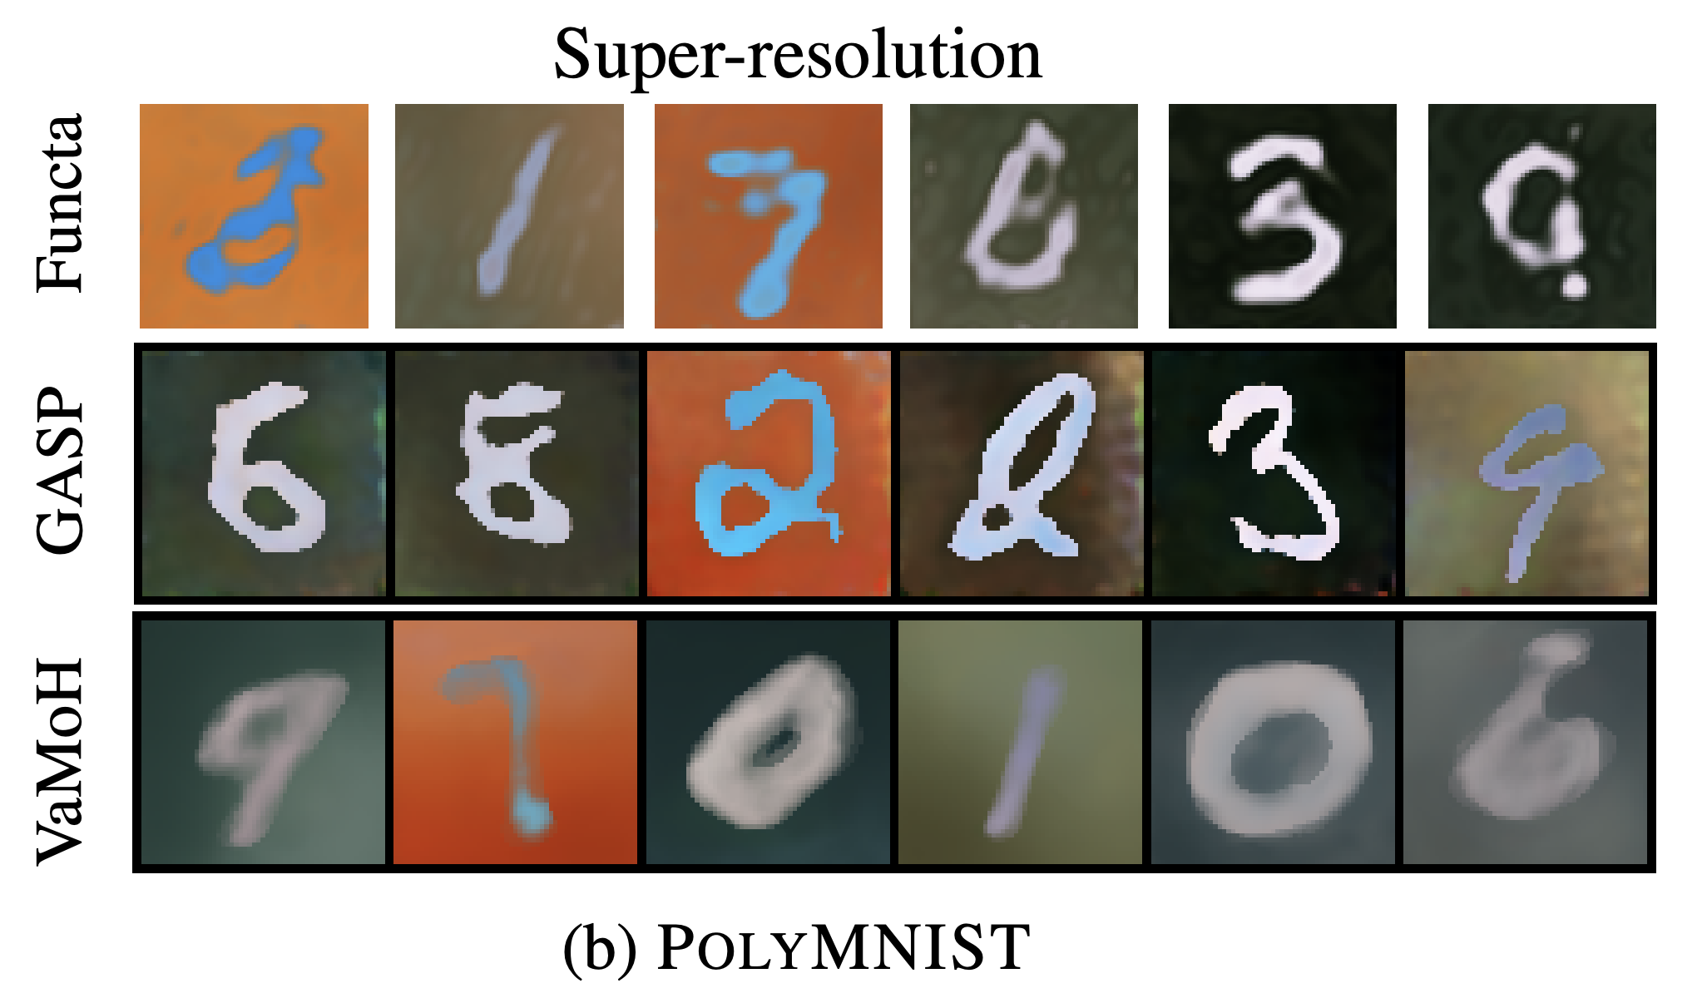
Results
We naturally generate samples with any desired resolution.

Slide 16
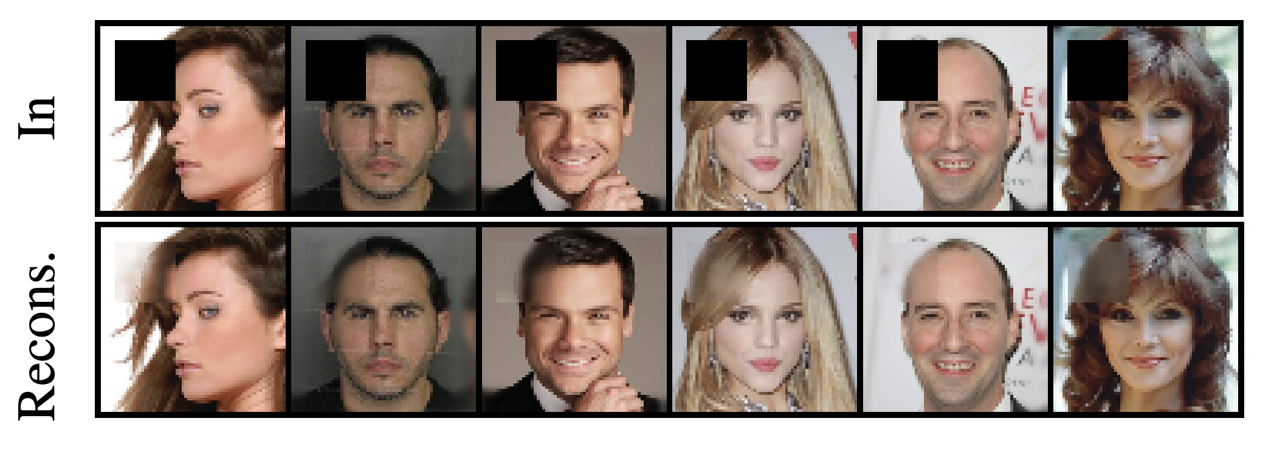
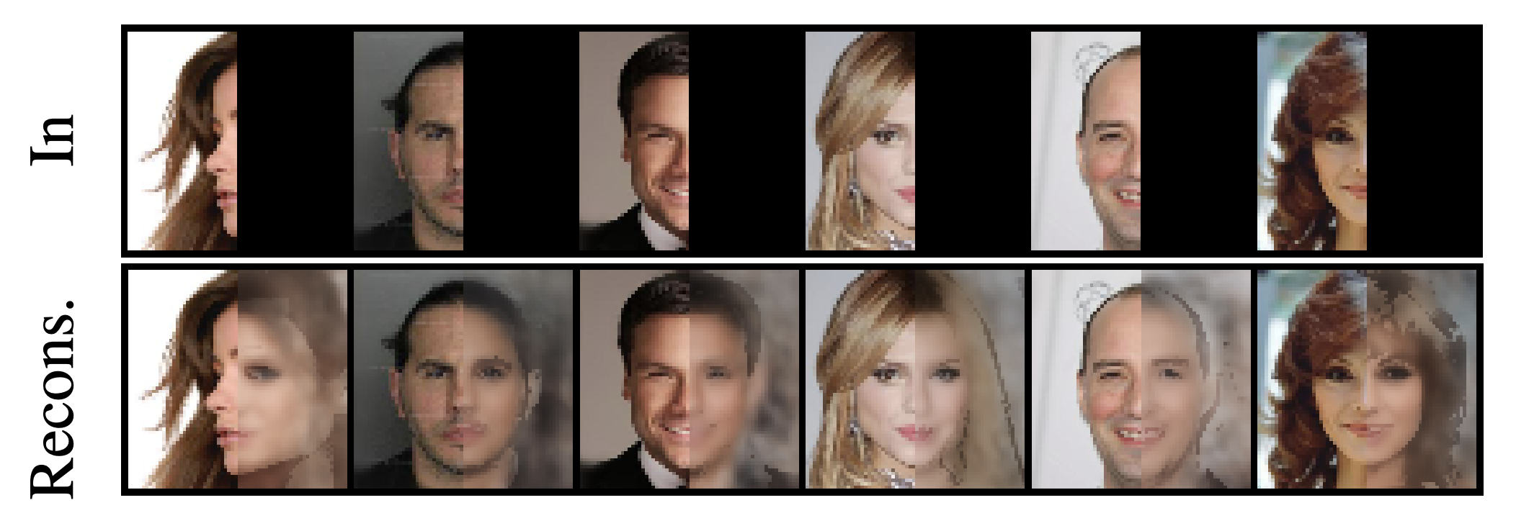
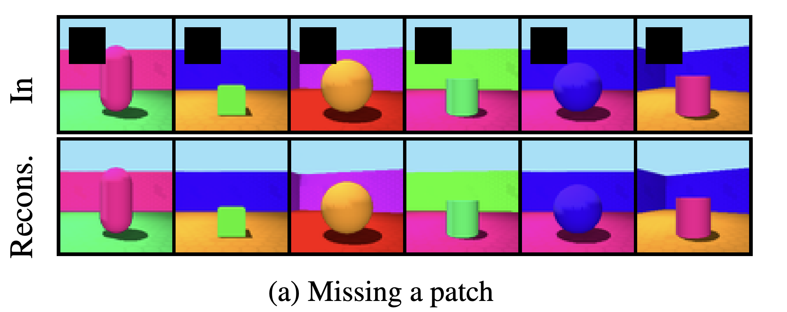
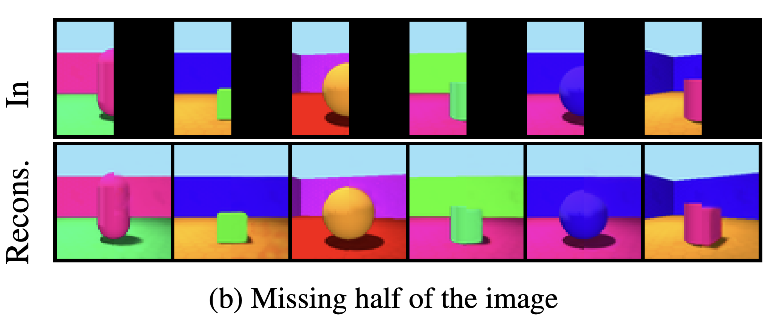
Results
Our method allows for efficient conditional generation via inference.

Slide 17
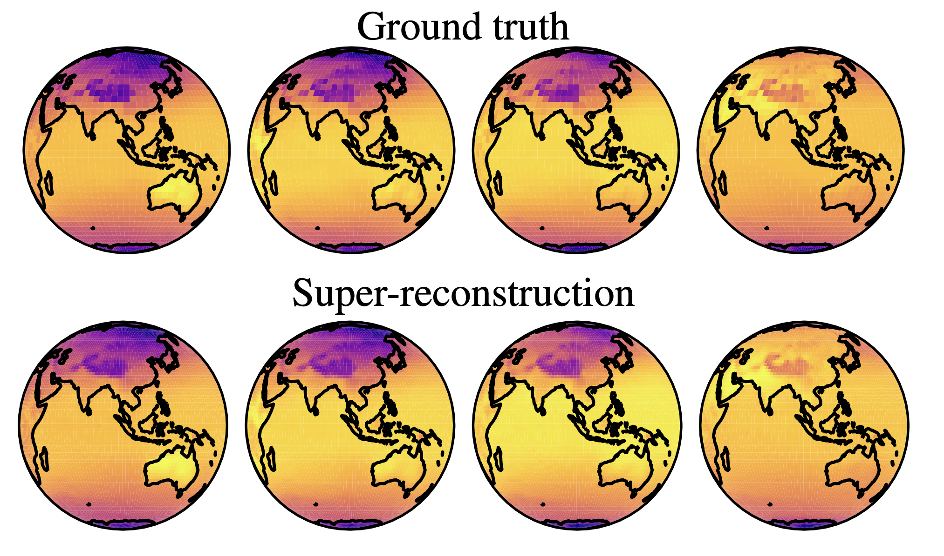
Results
Our method allows for efficient conditional generation via inference.

Slide 18
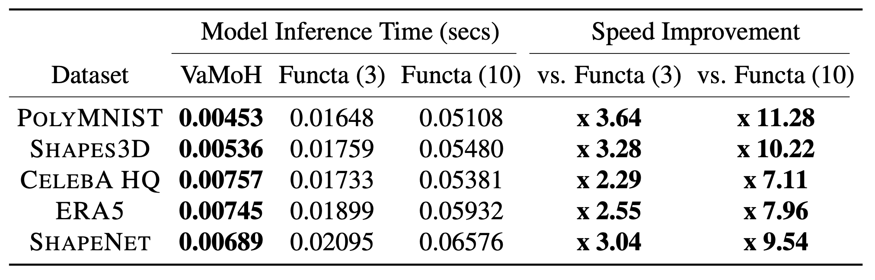
Results
We achieve a 7-11 times faster inference than the alternative!

Slide 19
Conclusion
Thanks to learning distributions of functions, our proposed VAMoH can:
“Sample” neural networks for generating new functions.
Infer the latent representation of a neural network for conditionally generating data.
Use the same neural architecture independently of the nature of the data.
Easily perform the conditional generation at any desired resolution, while being:
Robust to partially observed data.
Expressive for generating high-quality data.
Efficient in terms of inference.

Slide 20
References
[1] Goodfellow, I., Pouget-Abadie, J., Mirza, M., Xu, B., Warde-Farley, D., Ozair, S., ... & Bengio, Y. (2014). Generative adversarial nets. Advances in neural information processing systems, 27.
[2] Kingma, D. P., & Welling, M. (2013). Auto-encoding variational bayes. arXiv preprint arXiv:1312.6114.
[3] Ho, J., Jain, A., & Abbeel, P. (2020). Denoising diffusion probabilistic models. Advances in neural information processing systems, 33, 6840-6851.
[4] Song, Y., & Ermon, S. (2019). Generative modeling by estimating gradients of the data distribution. Advances in neural information processing systems, 32.
[5] LeCun, Y., Chopra, S., Hadsell, R., Ranzato, M., & Huang, F. (2006). A tutorial on energy-based learning. Predicting structured data, 1(0).
[6] Simonyan, K., & Zisserman, A. (2014). Very deep convolutional networks for large-scale image recognition. arXiv preprint arXiv:1409.1556.
[7] Dosovitskiy, A., Beyer, L., Kolesnikov, A., Weissenborn, D., Zhai, X., Unterthiner, T., ... & Houlsby, N. (2020). An image is worth 16x16 words: Transformers for image recognition at scale. arXiv preprint arXiv:2010.11929.
[8] Hochreiter, S., & Schmidhuber, J. (1997). Long short-term memory. Neural computation, 9(8), 1735-1780.
[9] Vaswani, A., Shazeer, N., Parmar, N., Uszkoreit, J., Jones, L., Gomez, A. N., ... & Polosukhin, I. (2017). Attention is all you need. Advances in neural information processing systems, 30.

Slide 21
References
[10] Sitzmann, V., Martel, J., Bergman, A., Lindell, D., & Wetzstein, G. (2020). Implicit neural representations with periodic activation functions. Advances in neural information processing systems, 33, 7462-7473.]
[11] Mescheder, L., Oechsle, M., Niemeyer, M., Nowozin, S., & Geiger, A. (2019). Occupancy networks: Learning 3d reconstruction in function space. In Proceedings of the IEEE/CVF conference on computer vision and pattern recognition (pp. 4460-4470).
[12] Stanley, K. O. (2007). Compositional pattern producing networks: A novel abstraction of development. Genetic programming and evolvable machines, 8, 131-162.
[13] Ha, D., Dai, A. M., and Le, Q. V. Hypernetworks. In International Conference on Learning Representations, 2017.
[14] Wu, W., Qi, Z., and Fuxin, L. Pointconv: Deep convolutional networks on 3d point clouds. In Proceedings of the IEEE/CVF Conference on Computer Vision and Pattern Recognition, pp. 9621–9630, 2019.
[15] Rombach, R., Blattmann, A., Lorenz, D., Esser, P., & Ommer, B. (2022). High-resolution image synthesis with latent diffusion models. In Proceedings of the IEEE/CVF conference on computer vision and pattern recognition (pp. 10684-10695).
[16] Rezende, D. and Mohamed, S. Variational inference with normalizing flows. In International Conference on Machine Learning, 2015.
[17] Dupont, E., Teh, Y. W., and Doucet, A. Generative models as distributions of functions. In International Conference on Artificial Intelligence and Statistics, pp. 2989–3015. PMLR, 2022a.
[18] Dupont, E., Kim, H., Eslami, S. A., Rezende, D. J., and Rosenbaum, D. From data to functa: Your data point is a function and you can treat it like one. In International Conference on Machine Learning, pp. 5694–5725. PMLR, 2022

Slide 22
Thank you!
[Paper]
[Code]

